Slide 1

Stallion RFID Enabled Warehouse Management System

Slide 2
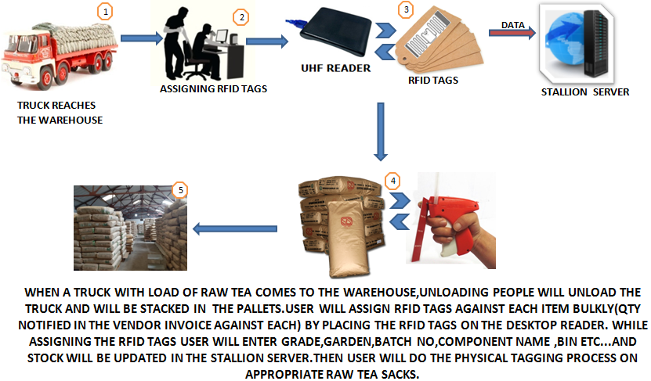
Process Flow - INWARD

Slide 3
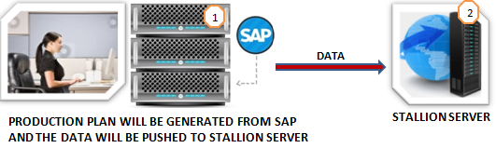
Process Flow – OUTWARD -1

Slide 4
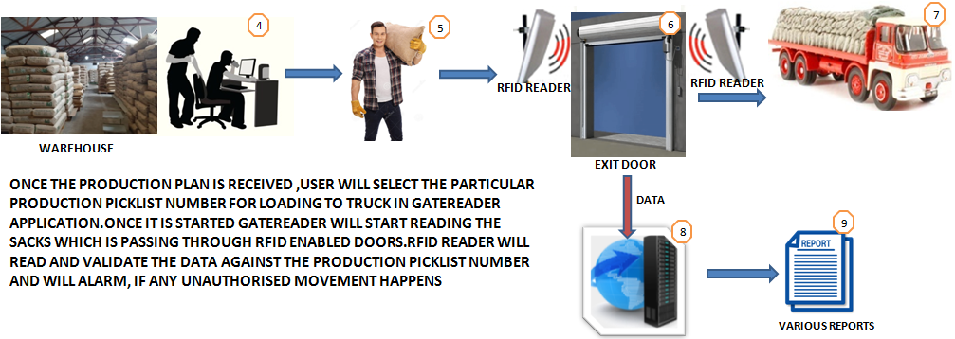
Process Flow – OUTWARD -2

Slide 5
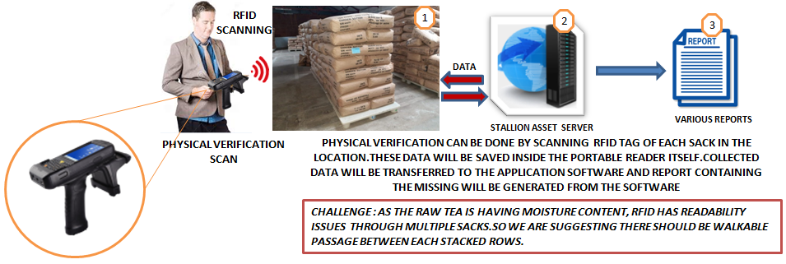
PHYSICAL VERIFICATION

Slide 6
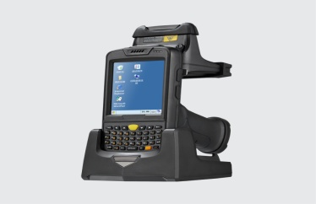



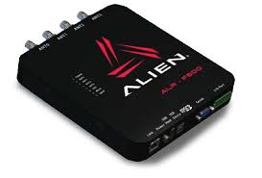
PRODUCTS

Slide 7
Thanks You
THANK Y
For your wathcing
PRESENTER NAME:PRAMOD C
CUSTOMER NAME: TATA GLOBAL BEVERAGES

